Slide 1
GAR
Session 04: Sokoban
Notes:
Welcome. Today we build Sokoban. The main topic: the Command pattern and undo.
Start by playing the finished game, Sokoban4, before any code.

Slide 2
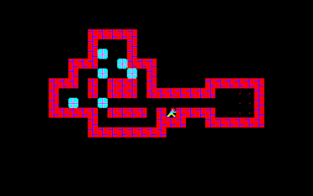
Sokoban
Sokoban (Thinking Rabbit, 1982). Screenshot © Thinking Rabbit.
Notes:
The original: Sokoban. Ask who has played it, and what they remember of how it plays.
Today we build the parts that matter for the architecture, not the whole game.

Slide 3
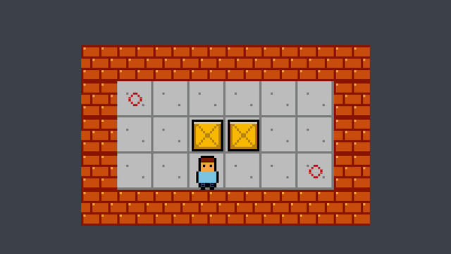
Today’s Goal
Notes:
Run Sokoban4 and play it for a minute.
Ask: what would you need to build this? Collect answers on the board, and come back to them at the end.

Slide 4
Today’s Topics
Levels as Data
Rules Apart From Drawing
Unit Tests
Command Pattern
Undo & Redo
Notes:
The main topic: the Command pattern, and undo. To get there: levels as data, rules apart from drawing, and our first unit tests.

Slide 5
Source Code
github.com/Metamate/gar-games, folder 04-sokoban
Its README: the steps (Sokoban0 to Sokoban4, and Sokoban.Tests), where things are in the code, how to run it
The course site: today’s concepts in full, the exercises, and questions to check yourself
Notes:
Open gar-games/04-sokoban live. Show the README: the step table, the code map, how to run a step.
Say: the site explains the ideas, the README helps you find them in the code, the slides are for today.

Slide 6
Levels as Data
Sokoban levels have been text for decades
  # wall $ box . goal @ player
  * box on a goal + player on a goal
Small, readable, easy to edit
Copied as they are, and read by our own code
Sokoban0 draws the text directly
  But then the text is the only state
// level1.txt
#######
# #
# @$ .#
# #
#######
// Builder.cs
content.IncludeCopy<WildcardRule>("*.txt");
// Game1.cs
using Stream stream = TitleContainer.OpenStream(
Path.Combine(Content.RootDirectory,
"levels/level1.txt"));
Notes:
Sokoban levels have been plain text for decades. Read the level on the right together: where are the box and the goal?
Builder.cs copies .txt files as they are; the game reads them itself.

Slide 7
Levels as Data Implementation
DEMO!
Sokoban0: a level file, drawn character by character
Notes:
Demo: run Sokoban0.
- level1.txt drawn character by character
- ask: what is the state of the game here? Only the text.

Slide 8
Try It: A Level in Text
In level1.txt:
Add a second box, a second goal, and a wall in the middle
What must be true for a level to be playable?
Notes:
Pairs, about 5 minutes. Sokoban0 only draws the text, so anything draws.
Answer: exactly one player, as many goals as boxes, walls all round, and every box able to reach a goal.

Slide 9
Rules Apart From Drawing
Level: the state and the rules
  Walls, goals, boxes, the player
  No textures, no keys, no screen
LevelView: draws a level, never changes it
  Which way the player faces is only drawing
Each part changes on its own
  New art: LevelView. New rule: Level
public MoveResult Move(Point direction)
{
if (!CanMove(direction))
return MoveResult.Blocked;
Player += direction;
if (HasBox(Player))
{
_boxes.Remove(Player);
_boxes.Add(Player + direction);
return MoveResult.Pushed;
}
return MoveResult.Walked;
}
public bool IsSolved =>
_boxes.All(_goals.Contains);
Notes:
Level holds the state and the rules; LevelView draws it and never changes it.
Ask: new art, which class? LevelView. A new rule? Level.

Slide 10
Rules Apart From Drawing Implementation
DEMO!
Sokoban0 → Sokoban1: Level and LevelView
Notes:
Demo: open Sokoban0 and Sokoban1 side by side (a diff tool, or two editor panes), then run Sokoban1.
- Level.Move returns what happened: walked, pushed, blocked
- LevelView only reads the level

Slide 11
Try It: Rules or Drawing?
In Sokoban1:
Make the walls look like floor
Make a level solved when all boxes but one are on goals
Which class did each change need?
Notes:
Pairs, about 5 minutes. Looks: LevelView (swap the tile numbers). Rule: Level.IsSolved.
Ask: did either change touch the other class? No; that is the point of the split.

Slide 12
Unit Tests
You change Level.Move. How do you know pushing still works?
By playing
slow, easy to skip a case,
and again after every change
A unit test
checks one thing, automatically;
hundreds run in a second
Arrange
set up a level
Act
do one thing
Assert
check the result
Possible only because Level needs no window, graphics or keys.
Notes:
Ask the question at the top first: how would you know pushing still works? Playing: slow, and easy to skip a case.
A test checks one thing automatically. Arrange, act, assert. Only possible because Level needs no window.

Slide 13
The Test Project
Tests live in their own project
  Sokoban.Tests, next to the game
  It references the game project
xUnit: a test framework
  Finds the tests, runs them, reports
The game knows nothing about its tests
  They never ship with the game
<!-- Sokoban.Tests.csproj -->
<ItemGroup>
<PackageReference
Include="Microsoft.NET.Test.Sdk" />
<PackageReference Include="xunit" />
<PackageReference
Include="xunit.runner.visualstudio" />
</ItemGroup>
<ItemGroup>
<ProjectReference
Include="..\Sokoban4\Sokoban4.csproj" />
</ItemGroup>
Notes:
Tests live in their own project that references the game. xUnit finds and runs them. The game knows nothing about its tests.

Slide 14
Anatomy of a Test
[Fact] marks a method as a test
The name says what it checks
  The first thing you see when it fails
Arrange, act, assert
  One situation, one action
Assert.Equal(expected, actual)
  Fails when the values differ
The level is written in the test
const string Corridor = """
#######
# @$ .#
#######
""";
[Fact]
public void Walking_into_a_box_pushes_it()
{
// Arrange
Level level = Level.Parse(Corridor);
// Act
MoveResult result =
level.Move(Direction.Right);
// Assert
Assert.Equal(MoveResult.Pushed, result);
Assert.Equal(new Point(3, 1), level.Player);
Assert.Equal([new Point(4, 1)], level.Boxes);
}
Notes:
Read the test together: the level is written in the test, one move, three asserts. The name says what it checks.

Slide 15
Running the Tests
dotnet test, in the game folder
Or your editor’s test explorer
  Green and red marks per test
A failing test names the rule that broke
  What it expected, what it got, the line
What to test: the rules
  Moving, pushing, solving, undo
  Not drawing: look at it instead
> dotnet test
Passed! - Failed: 0, Passed: 12, Total: 12
// After breaking Level.Move on purpose:
Failed LevelTests.Walking_into_a_box_pushes_it
Assert.Equal() Failure: Collections differ
Expected: [{X:4 Y:1}]
Actual: [{X:5 Y:1}]
at ...\LevelTests.cs:line 70
Failed! - Failed: 1, Passed: 11, Total: 12
Notes:
dotnet test in the game folder, or the test explorer. A failure names the rule, the expected and actual values, and the line.

Slide 16
Unit Tests Implementation
DEMO!
Sokoban.Tests: run the tests, then break a rule and watch one fail
Notes:
Demo: run dotnet test in 04-sokoban. Then break Level.Move on purpose (push the box two cells), run again, and read the failure together. Undo the change.

Slide 17
Try It: Your First Test
In the 04-sokoban folder: dotnet test
Copy one test in LevelTests.cs, and make it check walking left
Make it fail on purpose, and read the message
Notes:
Pairs, about 7 minutes. Everyone should see one test pass and one fail. The failure message names the test, the expected and the actual value, and the line.

Slide 18
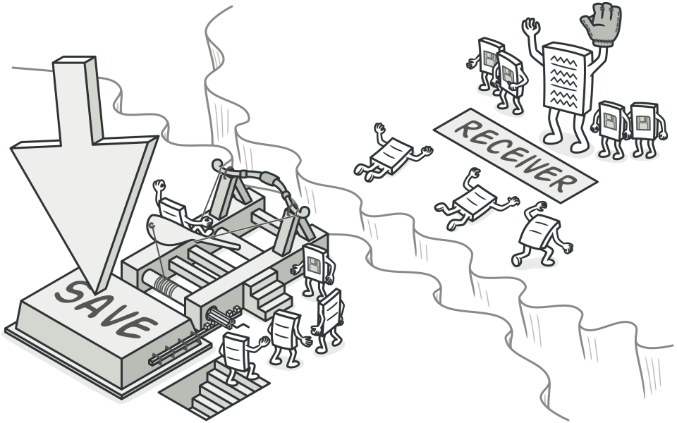
Command Pattern
Notes:
“Turn a request into an object.” Once a request is an object, you can store it, queue it, log it, undo it.

Slide 19
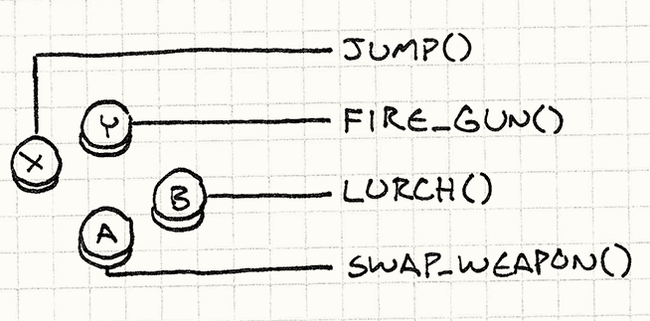
Command Pattern: Problem
public void Update(GameTime gameTime)
{
if (isPressed(BUTTON_X)) Jump();
if (isPressed(BUTTON_Y)) FireGun();
if (isPressed(BUTTON_A)) SwapWeapon();
if (isPressed(BUTTON_B)) Lurch();
}
Notes:
Each button is hardwired to one action. Ask: how would you let players remap buttons? Or record a replay?

Slide 20
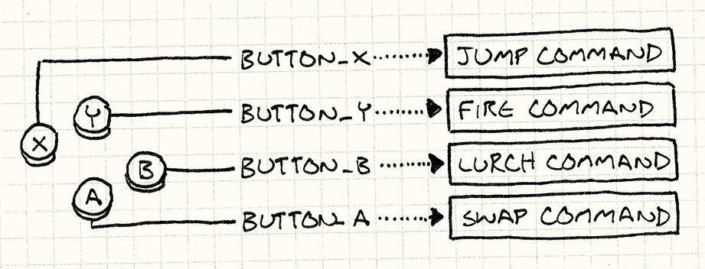
Command Pattern: Solution
“A command is a reified method call.”
Notes:
A command is a reified method call: the call, made into an object you can hold on to.

Slide 21
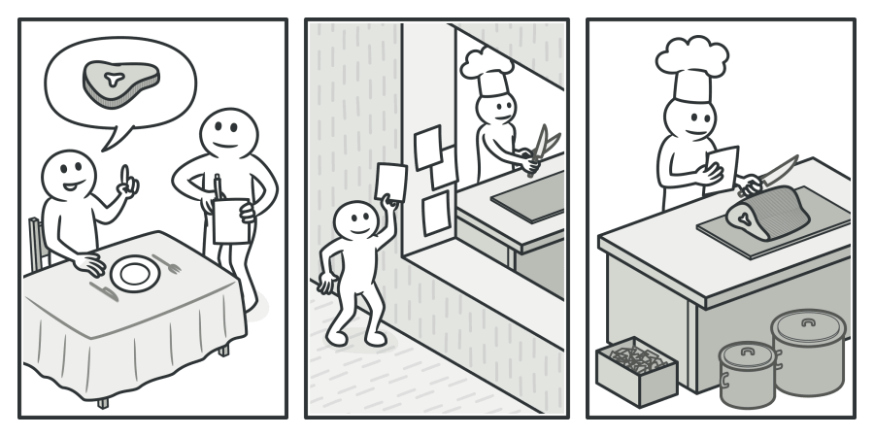
Command Pattern: Solution
Notes:
The structure: an invoker holds commands and calls Execute; each command knows its receiver.

Slide 22
Command Pattern: Solution
public interface ICommand
{
void Execute();
}
public ICommand ButtonX { get; set; } = new JumpCommand();
public ICommand ButtonY { get; set; } = new FireCommand();
public ICommand ButtonB { get; set; } = new LurchCommand();
public ICommand ButtonA { get; set; } = new SwapCommand();
public void Update(GameTime gameTime)
{
if (isPressed(BUTTON_X)) ButtonX.Execute();
if (isPressed(BUTTON_Y)) ButtonY.Execute();
if (isPressed(BUTTON_A)) ButtonA.Execute();
if (isPressed(BUTTON_B)) ButtonB.Execute();
}
public class JumpCommand() : ICommand
{
public void Execute()
{
Jump();
}
}
Notes:
The buttons now hold commands. Remapping is assigning a different command.

Slide 23
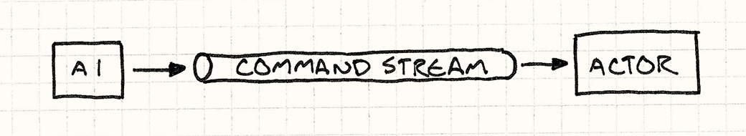
Command Pattern
Notes:
The pattern’s class diagram. Point out the one method every command has.

Slide 24
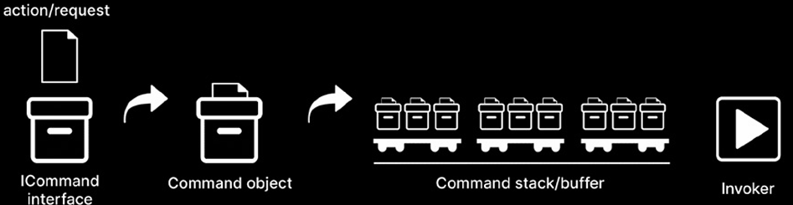
Command Pattern
Notes:
The sequence: the client creates a command, the invoker executes it later.

Slide 25
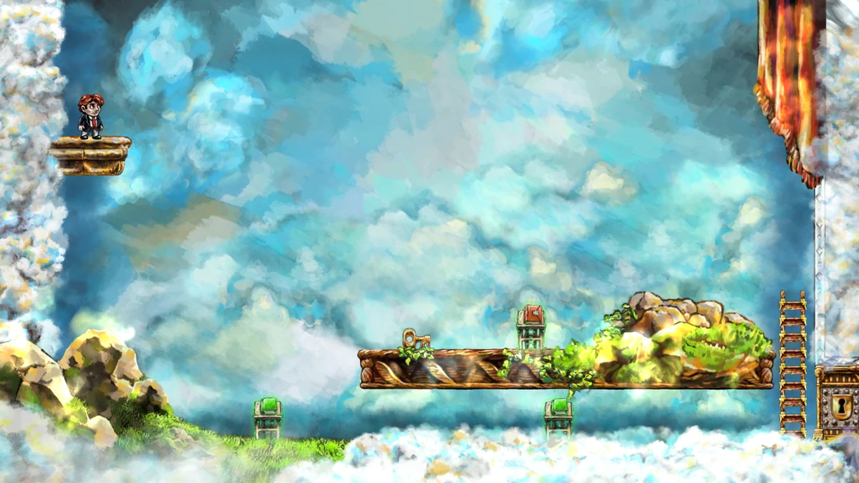
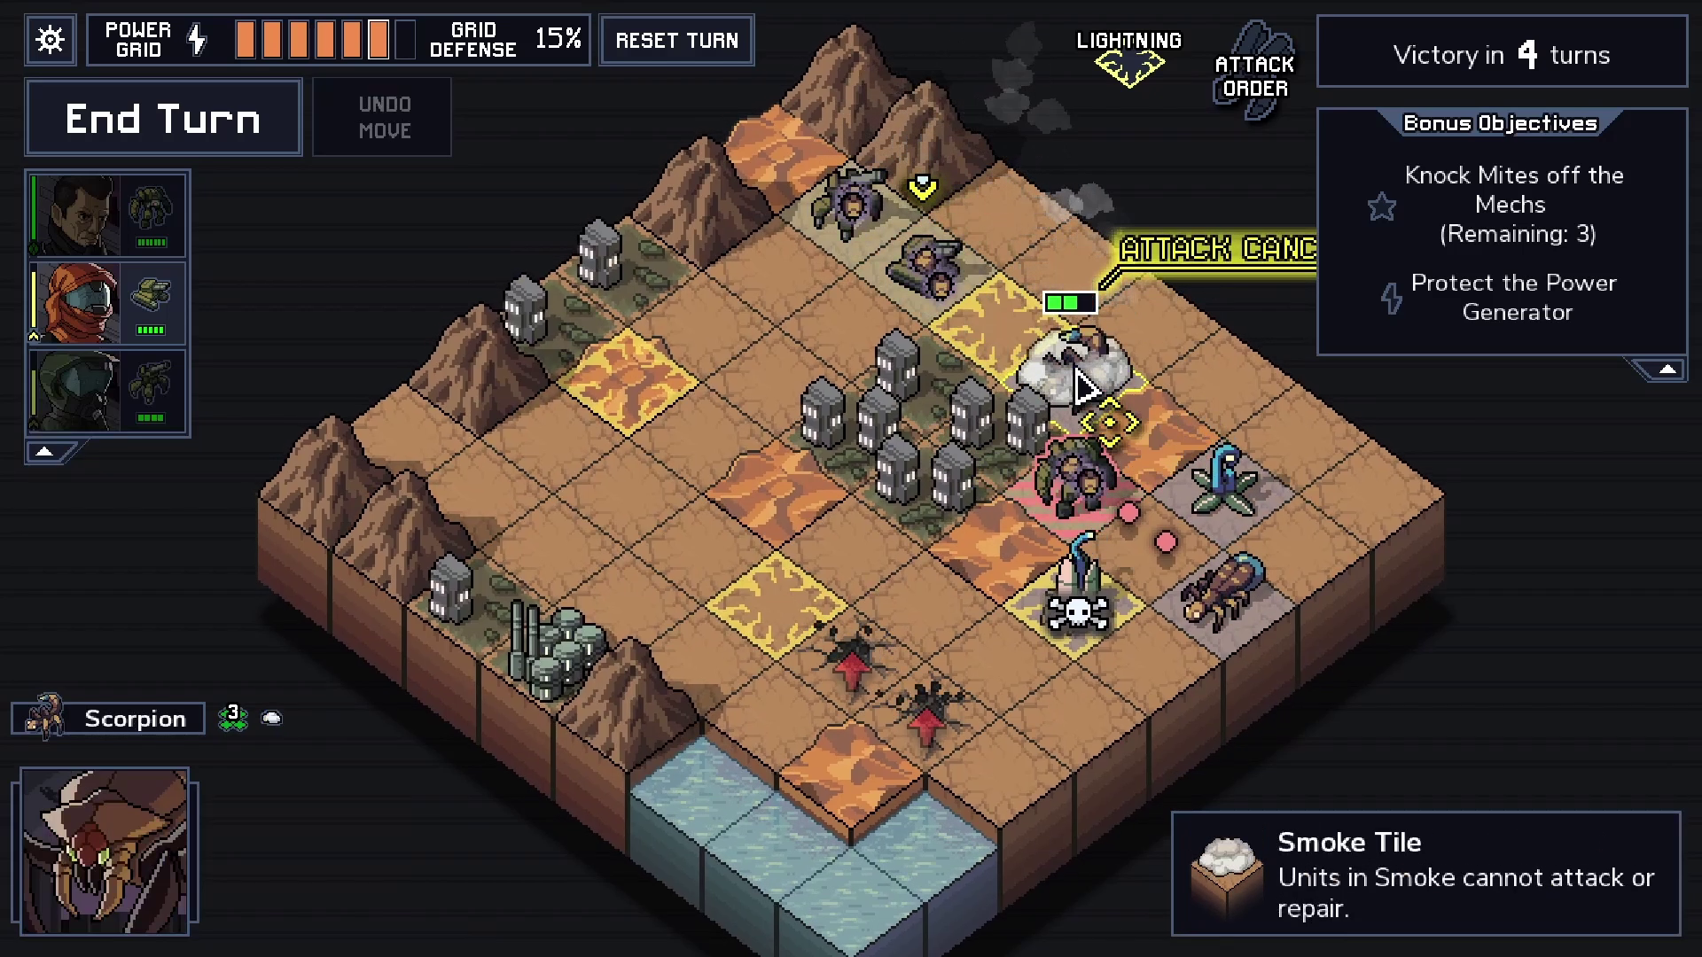
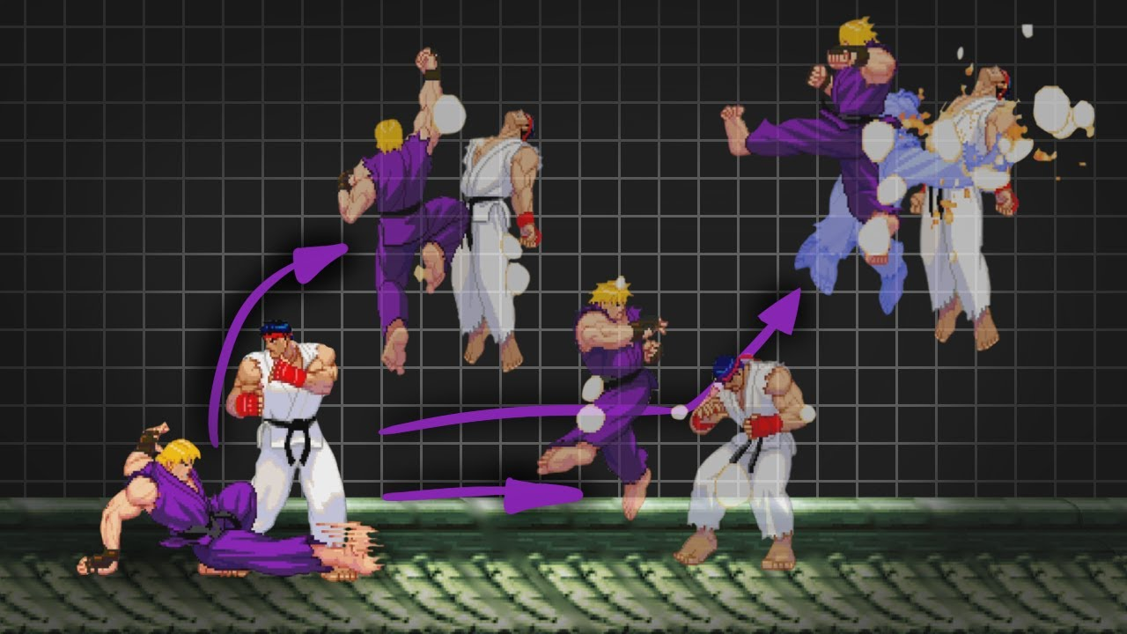
Command Pattern: Usage
Input
Undo
Redo
Notes:
Input, undo and redo: three uses of the same idea. Today we do all three.

Slide 26
Moves as Commands
Each move becomes a MoveCommand
Only moves that change something
  Walking into a wall is not a move
Sokoban2 keeps a list, to count the moves
A move that is an object can be kept
  Queued, logged, replayed, sent, undone
GameController: keys → actions
  A command: what the game does with one
public class MoveCommand(Level level,
Point direction) : ICommand
{
public void Execute() =>
level.Move(direction);
}
// Game1.cs
if (!_level.CanMove(direction))
return;
ICommand command =
new MoveCommand(_level, direction);
command.Execute();
_moves.Add(command);
Notes:
In Sokoban, every move is a MoveCommand. Only moves that change something become commands.
Ask: why keep a list of them? To count moves; and, next, to undo them.

Slide 27
Try It: What a Move Remembers
In Sokoban2:
Give MoveCommand a Direction property
Show the last move’s direction in the window title
To undo a move, what else would it need to remember?
Notes:
Pairs, about 7 minutes. The command already gets the direction; it only has to keep it.
Answer to the question: whether it pushed a box (the MoveResult). That is the next step, undo.

Slide 28
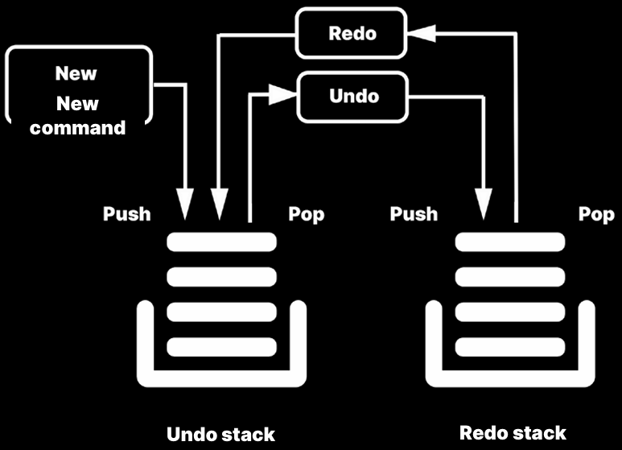
Adding Undo/Redo Functionality
Notes:
Undo: a command also knows how to reverse itself.

Slide 29
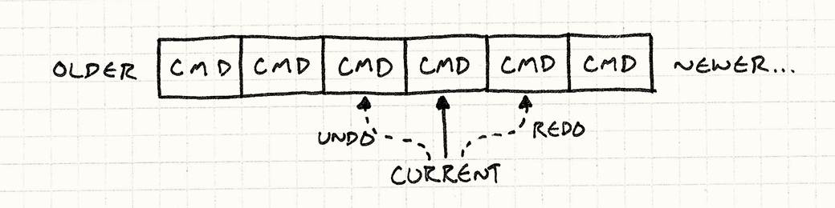
Adding Undo/Redo Functionality
Notes:
Two stacks: done and undone.

Slide 30
Undoable Moves
A command must reverse exactly what it did
Moving the player back is not enough
  A push must pull the box back too
So MoveCommand remembers the MoveResult
private MoveResult _result;
public void Execute() =>
_result = level.Move(direction);
public void Undo() =>
level.UndoMove(direction, _result);
// Level.cs
public void UndoMove(Point direction,
MoveResult result)
{
if (result == MoveResult.Pushed)
{
_boxes.Remove(Player + direction);
_boxes.Add(Player);
}
if (result != MoveResult.Blocked)
Player -= direction;
}
Notes:
Ask: is moving the player back enough? No: a push must pull the box back too. So the command remembers what happened.

Slide 31
Command History
Two stacks: done and undone
Z undoes, Y redoes
A new command clears the redo stack
  The undone moves can’t be redone any more
The move counter is the undo stack’s size
public void Execute(ICommand command)
{
command.Execute();
_done.Push(command);
_undone.Clear();
}
public void Undo()
{
if (_done.TryPop(out ICommand command))
{
command.Undo();
_undone.Push(command);
}
}
// Redo: the same, the other way around
Notes:
Walk through Execute and Undo. Ask: why clear the redo stack on a new command? Those undone moves belong to another future.

Slide 32
Two Ways to Undo
Undo by reversing each command, or by restoring a snapshot.
Reverse the command
each command knows its opposite
cheap, but every undo
must be exactly right
Save snapshots
copy the state before each command
simple and always correct,
but costs memory
Sokoban’s state is tiny. What about a big open world?
Notes:
Reverse each command, or restore a snapshot. Ask the question at the bottom: in a big open world, you can’t copy everything; store only what changed.

Slide 33
Command Pattern Implementation
DEMO!
Sokoban2 → Sokoban3 → Sokoban4: commands, undo & redo, the whole game
Notes:
Demo: open Sokoban2 and Sokoban3 side by side (a diff tool, or two editor panes), then run Sokoban3.
- MoveCommand and CommandHistory
- Z and Y in the running game
- then Sokoban4: seven levels, restart, the move counter

Slide 34
Exercises
Start from Sokoban4. Full instructions are on the course site.
A new level: design level8.txt. Is it solvable?
Two more tests: pushing a box off a goal, walking onto a goal
Test first: boxes can’t be pushed onto ice (~)
Replay: when a level is solved, replay the solution
Notes:
Start from Sokoban4. The tests exercises matter most: after the first test in class, everyone should add the two missing cases.
The new level only shows up once LevelCount in Game1 is raised. Ask: why is that constant a smell for levels that are data? The game could count the level files instead.

Slide 35
Exercise: Commands
Restart as a command
  Make R a command too, so a restart can be undone
  What must it remember?
Stretch: snapshot undo
  Replace CommandHistory with a history of Level snapshots
  Compare: code, memory, and how easy each is to get wrong
Notes:
Restart as a command: ask what it must remember (the whole level before). Stretch: snapshot undo, and compare.

Slide 36
Check Yourself
What does turning a request into an object make possible?
Why does a move command remember whether it pushed a box?
Why is the redo stack cleared when a new command is executed?
Why can Level be unit-tested, but not code in Game1.Update?
The answers, and more questions, are on the course site.
Notes:
Ask one question at a time. Pairs discuss for a minute, then take two or three answers.
Expected answers (from the course site):
Q: What does it mean to turn a request into an object, and what does it make possible?
A: Instead of calling a method directly, you create an object that represents the call. It can then be stored, queued, logged, replayed, sent over the network, or undone, because it still exists after it has run.
Q: Why does a move command have to remember whether it pushed a box?
A: Undoing a walk only moves the player back. Undoing a push must also move the box back. The level after the move doesn't tell which one happened, so the command must remember it.
Q: Why is the redo stack cleared when a new command is executed?
A: The undone commands belong to a different future. After a new move, the state they were made for no longer exists, so redoing them could leave the level in an impossible state.
Q: What is a unit test, and what are its three parts?
A: A small piece of code that checks one thing about your code automatically. It arranges a situation, acts (does one thing), and asserts that the result is what it should be.
Q: Why can Level be unit-tested, but not code in Game1.Update?
A: Level only depends on its own data, so a test can create one from a string. Game1 needs a window, a graphics device, content and real key presses.

Slide 37
Apply It to Your Project
Which rules could be separated from drawing and input?
  Write one unit test for one of them
Would undo, replays or queued actions be useful in your game?
  Which actions would become commands, and what would each remember?
Could your levels, or part of them, be data files?
Notes:
Give the project groups five minutes with these questions.
Ask two groups to share one answer each, and push them to name actual classes and files.

